Slide 1

“Data analysis on Used Bikes prices“
In bikewale website

Slide 2
About me
Name : Raj kumar
Qualification : B.Tech (Cse)
Any work experience : Fresher
I want to learn data science for skills and
career transition.
It has great job opportunities.

Slide 3
Agenda
Objective of the Project
Web Scraping
Summary of the Data
Exploratory Data Analysis:
Data Cleaning
Data Manipulation
Univariate Analysis
Bivariate Analysis
Multivariate Analysis
Conclusion

Slide 4

Problem statement :
Find which type of used bikes are available in cities and what are the different price ranges of the bikes.
Objective of the Project :
Finding a desired Used Bikes in the affordable price with respect to City.
To visualize the data using various visualization techniques.

Slide 5
What is Web Scraping ?
Web scraping, also known as data mining, is the process of collecting large amounts of data from the website.
It takes the unstructured data into structured data that can be stored and analyzed , Save the data in a CSV file or some other structured format.
Make a request to these URLs to get the HTML of the page.
Beautiful Soup is a Python library for pulling data out of HTML and XML files.
Selenium: It was created primarily for automated web testing, but due to its compatibility with JavaScript, it is also used for web scraping.

Slide 6










Tools used for Web Scraping ,Cleaning and Visualization :
Web scraping Tools
Data Cleaning
& Manipulating
Data visualization

Slide 7
Summary :
I have selected Bike wale website for our web scraping project.
Request to the website
page = requests.get('https://www.bikewale.com/used/bikes-in-mumbai/')
Import Beautiful Soup and all the necessary libraries for scraping data
Check length’s of all columns and create the DataFrame .
Export into .csv format and read csv file and clean the Data
Analysis of Univariate, Bivariate and Multivariate

Slide 8
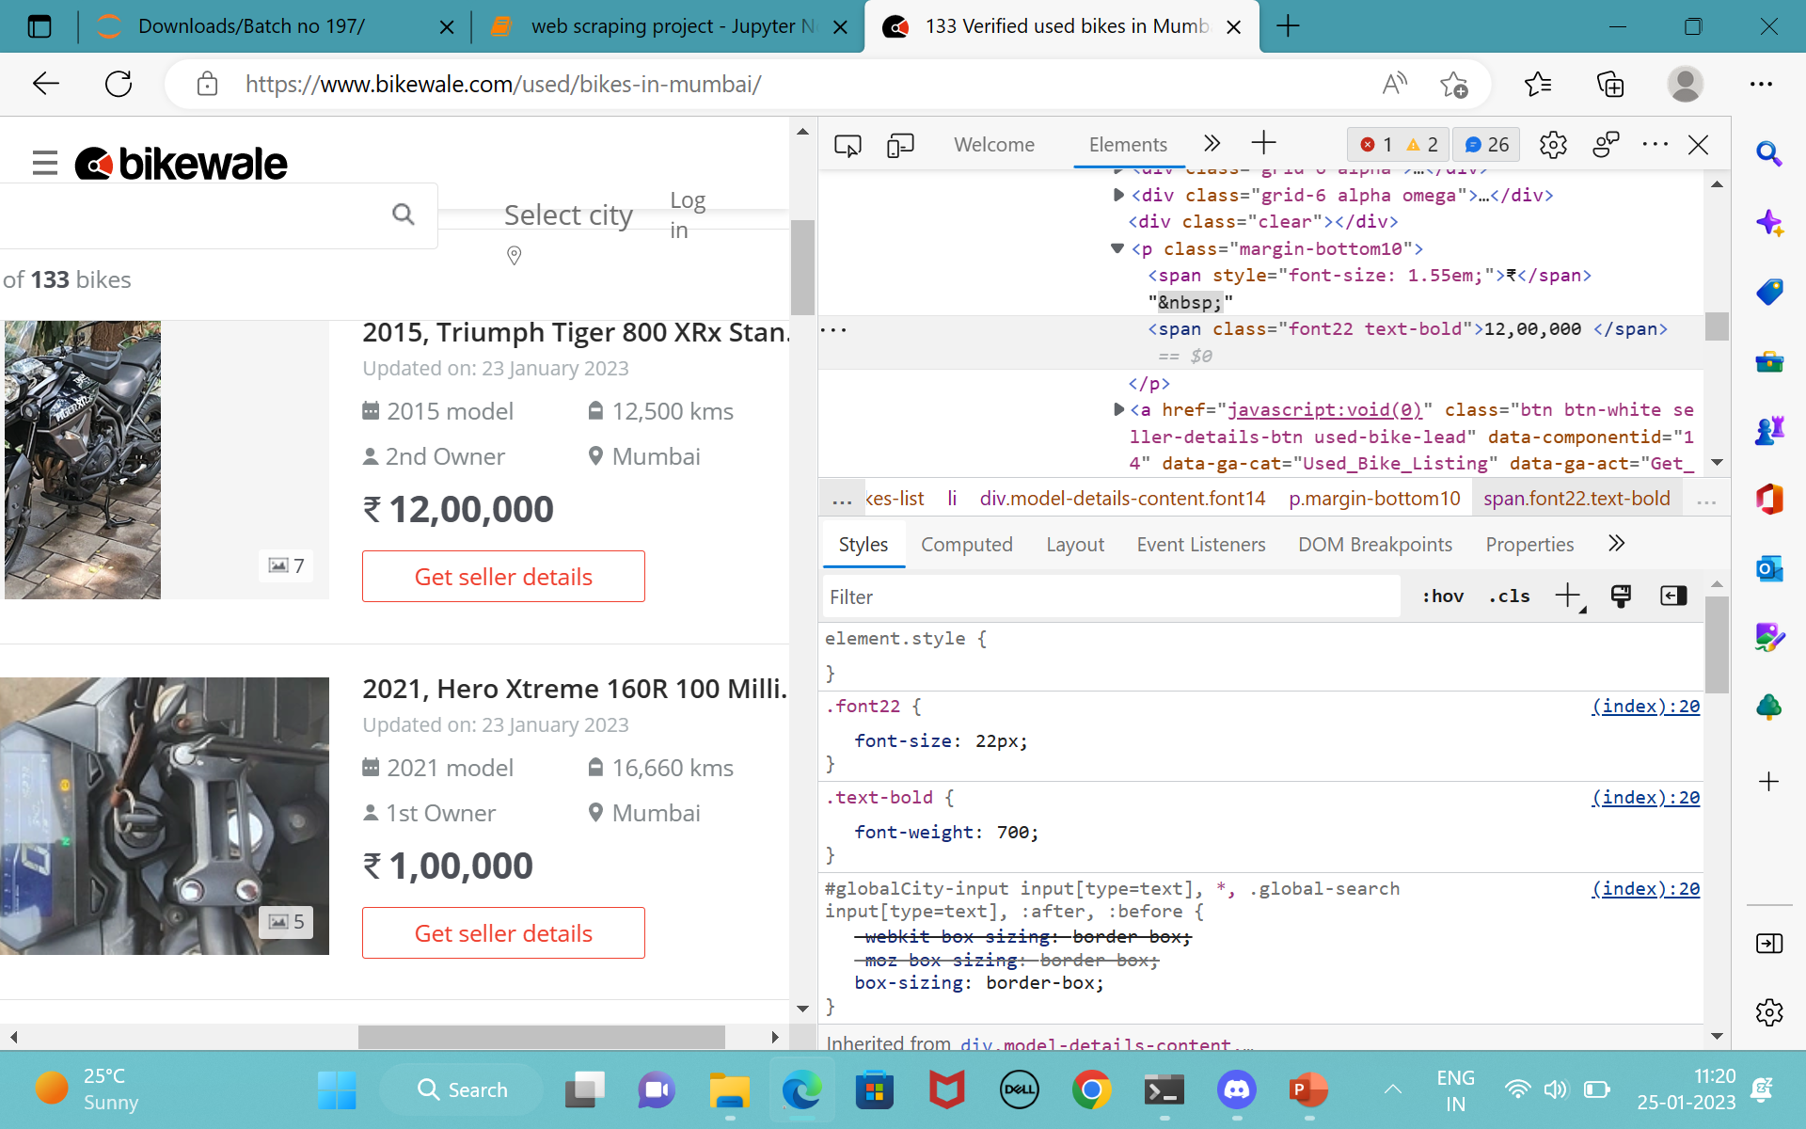
Website Used for Scraping

Slide 9
Collected Raw Data From Bikewale Website
 | brand | sub_brand | model_year | owner | kms_driven | price | location
0 | Yamaha | Fascino | 2016 | 1 | 70000 | 25000 | Hyderabad
1 | Hero | Splendor | 2016 | 1 | 30000 | 50000 | Hyderabad
2 | Yamaha | FZ25 | 2021 | 1 | 6630 | 169000 | Hyderabad
3 | Royal | Enfield | 2019 | 1 | 11000 | 250000 | Hyderabad
4 | Honda | CB | 2016 | 1 | 30000 | 80000 | Hyderabad
... | ... | ... | ... | ... | ... | ... | ...
692 | Hero | Honda | 2007 | 2 | 60000 | 20000 | Chennai
693 | Yamaha | Fazer | 2011 | 1 | 30000 | 38000 | Chennai
694 | Yamaha | FZ | 2022 | 1 | 3300 | 135000 | Chennai
695 | Yamaha | SZ-RR | 2016 | 1 | 50000 | 35000 | Chennai
696 | Yamaha | YZF | 2009 | 1 | 30000 | 45000 | Chennai
697 rows × 7 columns

Slide 10

Data Cleaning Steps:
Check for Duplicates
Drop the duplicate column and unnecessary columns.
Checking and removing special characters.
Identifying and imputing missing values.
Data Type conversion.

Slide 11
Cleaned Data
brand | sub_brand | model_year | owner | kms_driven | price | location
0 | Yamaha | Fascino | 2016 | 1 | 70000 | 25000 | Hyderabad
1 | Hero | Splendor | 2016 | 1 | 30000 | 50000 | Hyderabad
2 | Yamaha | FZ25 | 2021 | 1 | 6630 | 169000 | Hyderabad
3 | Royal | Enfield | 2019 | 1 | 11000 | 250000 | Hyderabad
4 | Honda | CB | 2016 | 1 | 30000 | 80000 | Hyderabad
... | ... | ... | ... | ... | ... | ... | ...
683 | Hero | Honda | 2007 | 2 | 60000 | 20000 | Chennai
684 | Yamaha | Fazer | 2011 | 1 | 30000 | 38000 | Chennai
685 | Yamaha | FZ | 2022 | 1 | 3300 | 135000 | Chennai
686 | Yamaha | SZ-RR | 2016 | 1 | 50000 | 35000 | Chennai
687 | Yamaha | YZF | 2009 | 1 | 30000 | 45000 | Chennai
688 rows × 7 columns

Slide 12
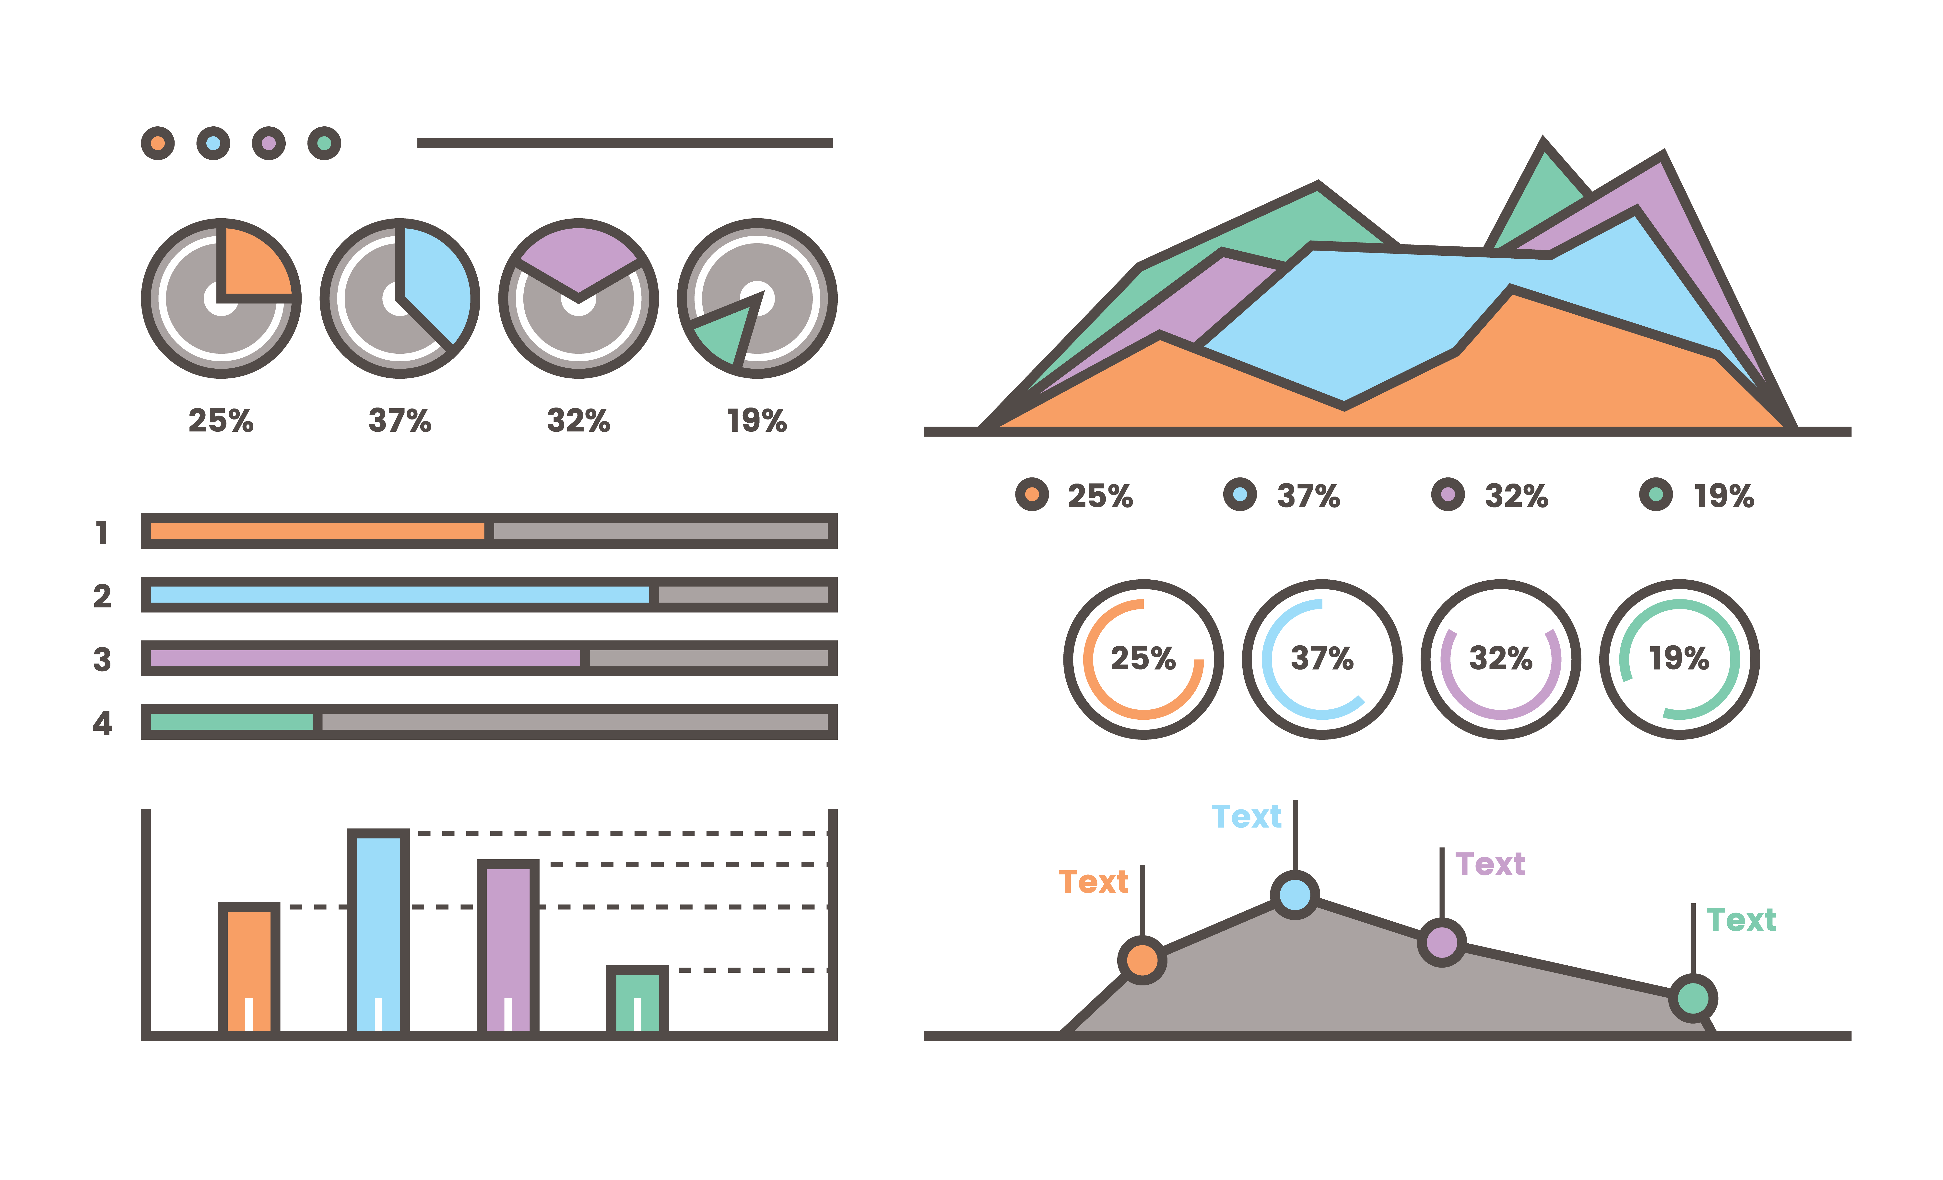
Data Visualisation

Slide 13
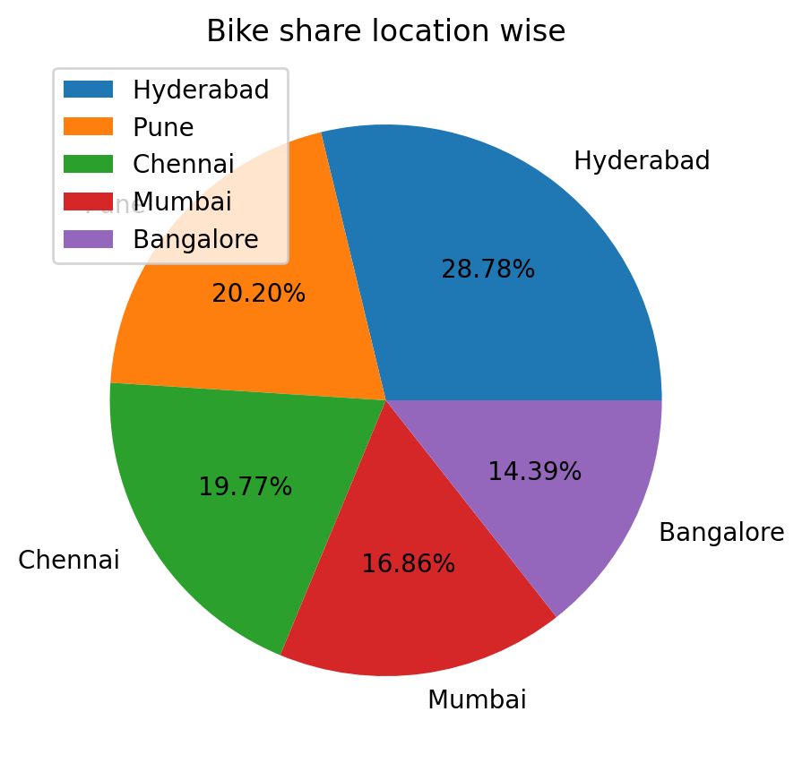
Bike share location wise :
Analysis Of Different Cities
Observation :
We can see that,
Used bikes available in Hyderbad it contributes high (28.78 %) .
Bangalore contributes less (14.39 %) in the DataFrame.

Slide 14
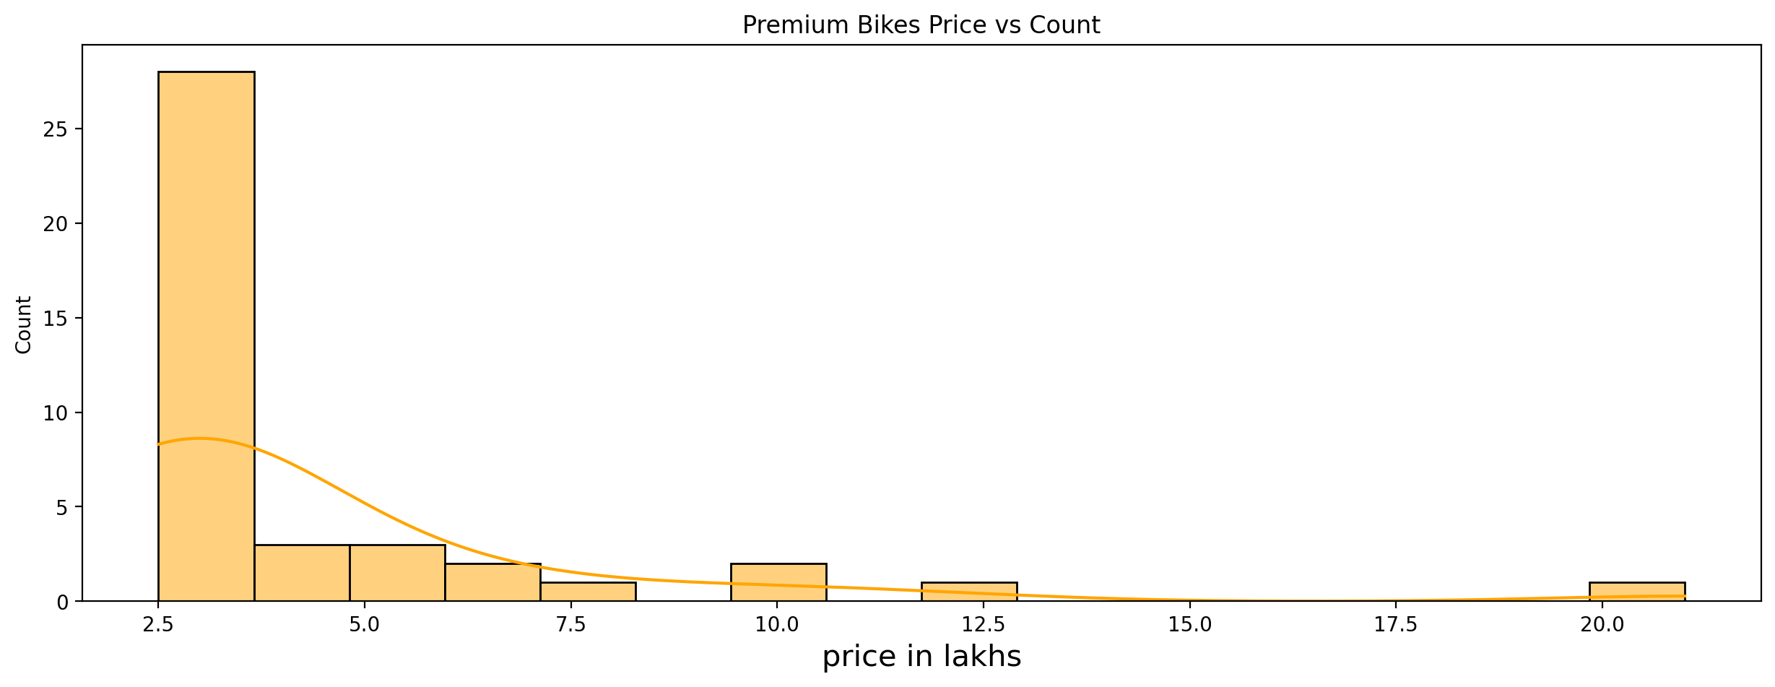
Premium bikes Price vs Count :
Observation :
We can see that more affordable Used bikes available are in the range of 2.5 lakh to 20 lakhs.

Slide 15
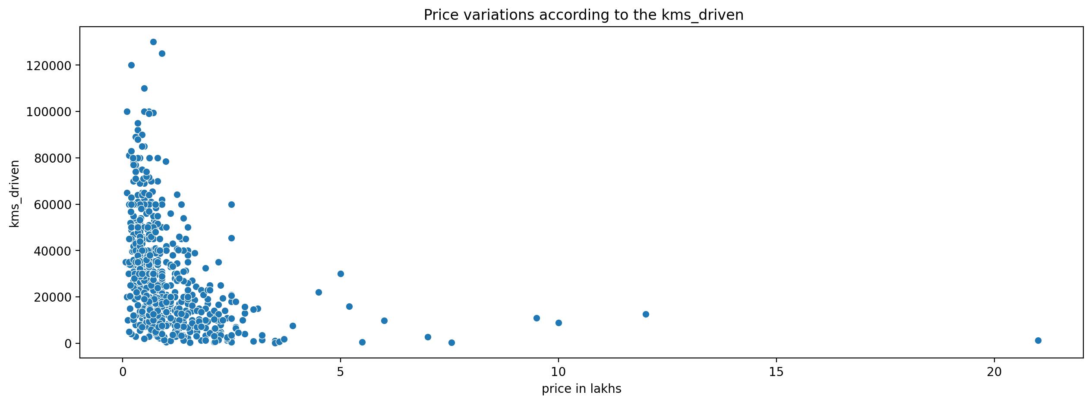
Price variations according to the kms_driven :
Observation :
Here the range of driven kilometers increased then the price decreased.
And the range of driven kilometers decreased then the price increased.

Slide 16
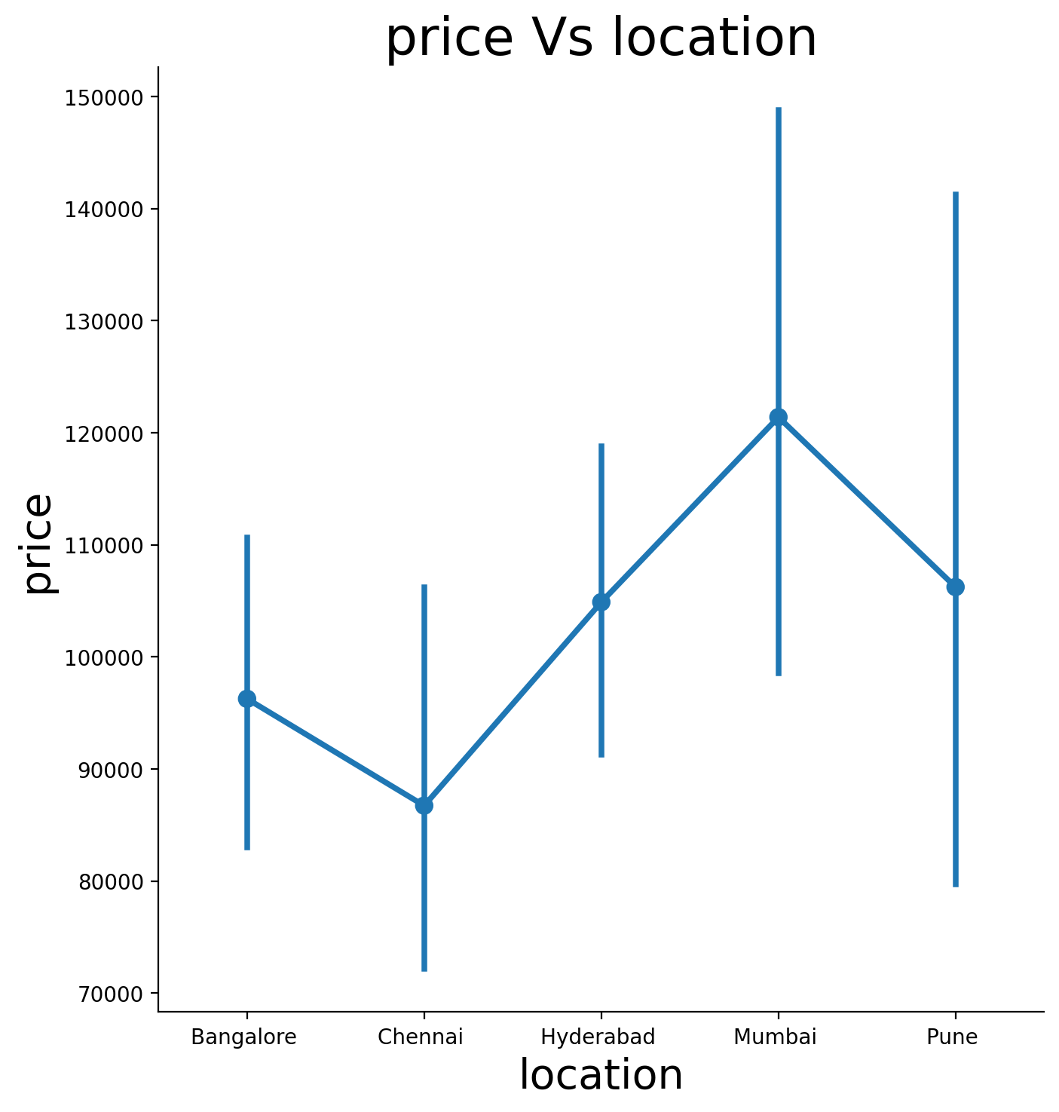
Premium bikes location and Price :
Observation :
Here we can observe that Mumbai has higher price.

Slide 17
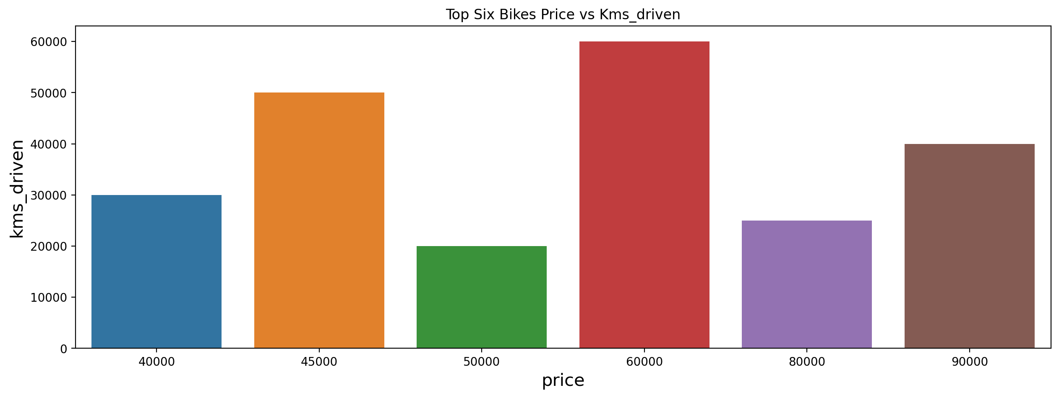
Top six bikes Price vs Kms_driven :
Observation :
We can easily observe that in 50000 price range the no of kms driven is low.
In 60000 price range the no of kms driven is high.

Slide 18
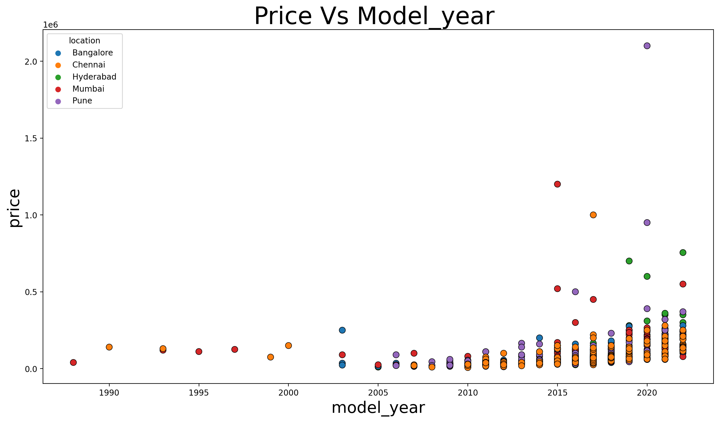
Location based on Price and Model_year :
Observation :
Here we can see that if model year increases then price of the used bikes increases.
From the model year 2015 to 2020 the price of the bikes increased.
Used bikes in Pune has the highest price in the model year 2020.
And Used bikes in Chennai has the lowest price in the model year 2020.

Slide 19
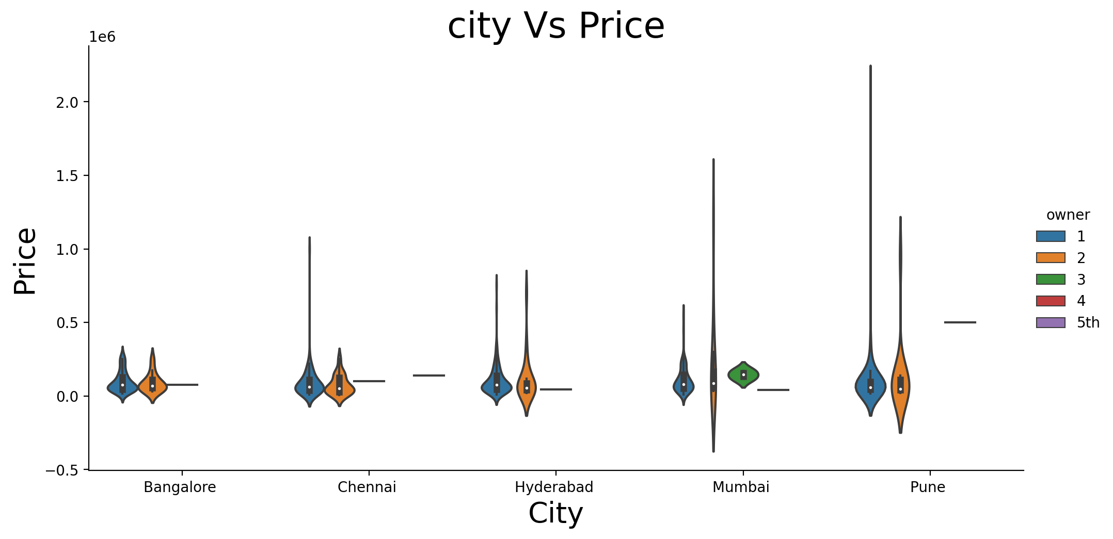
Ownersahip based on City and Price :
Observation :
Here we can see that in Pune city, the 1st Owner used bikes have highest price and the 2nd have the lowest.
In the Bangalore city Both the 1st and 2nd Owner Used bikes prices are equal.
Rather than other cities Mumbai city has the 3rd Owner used bikes.

Slide 20
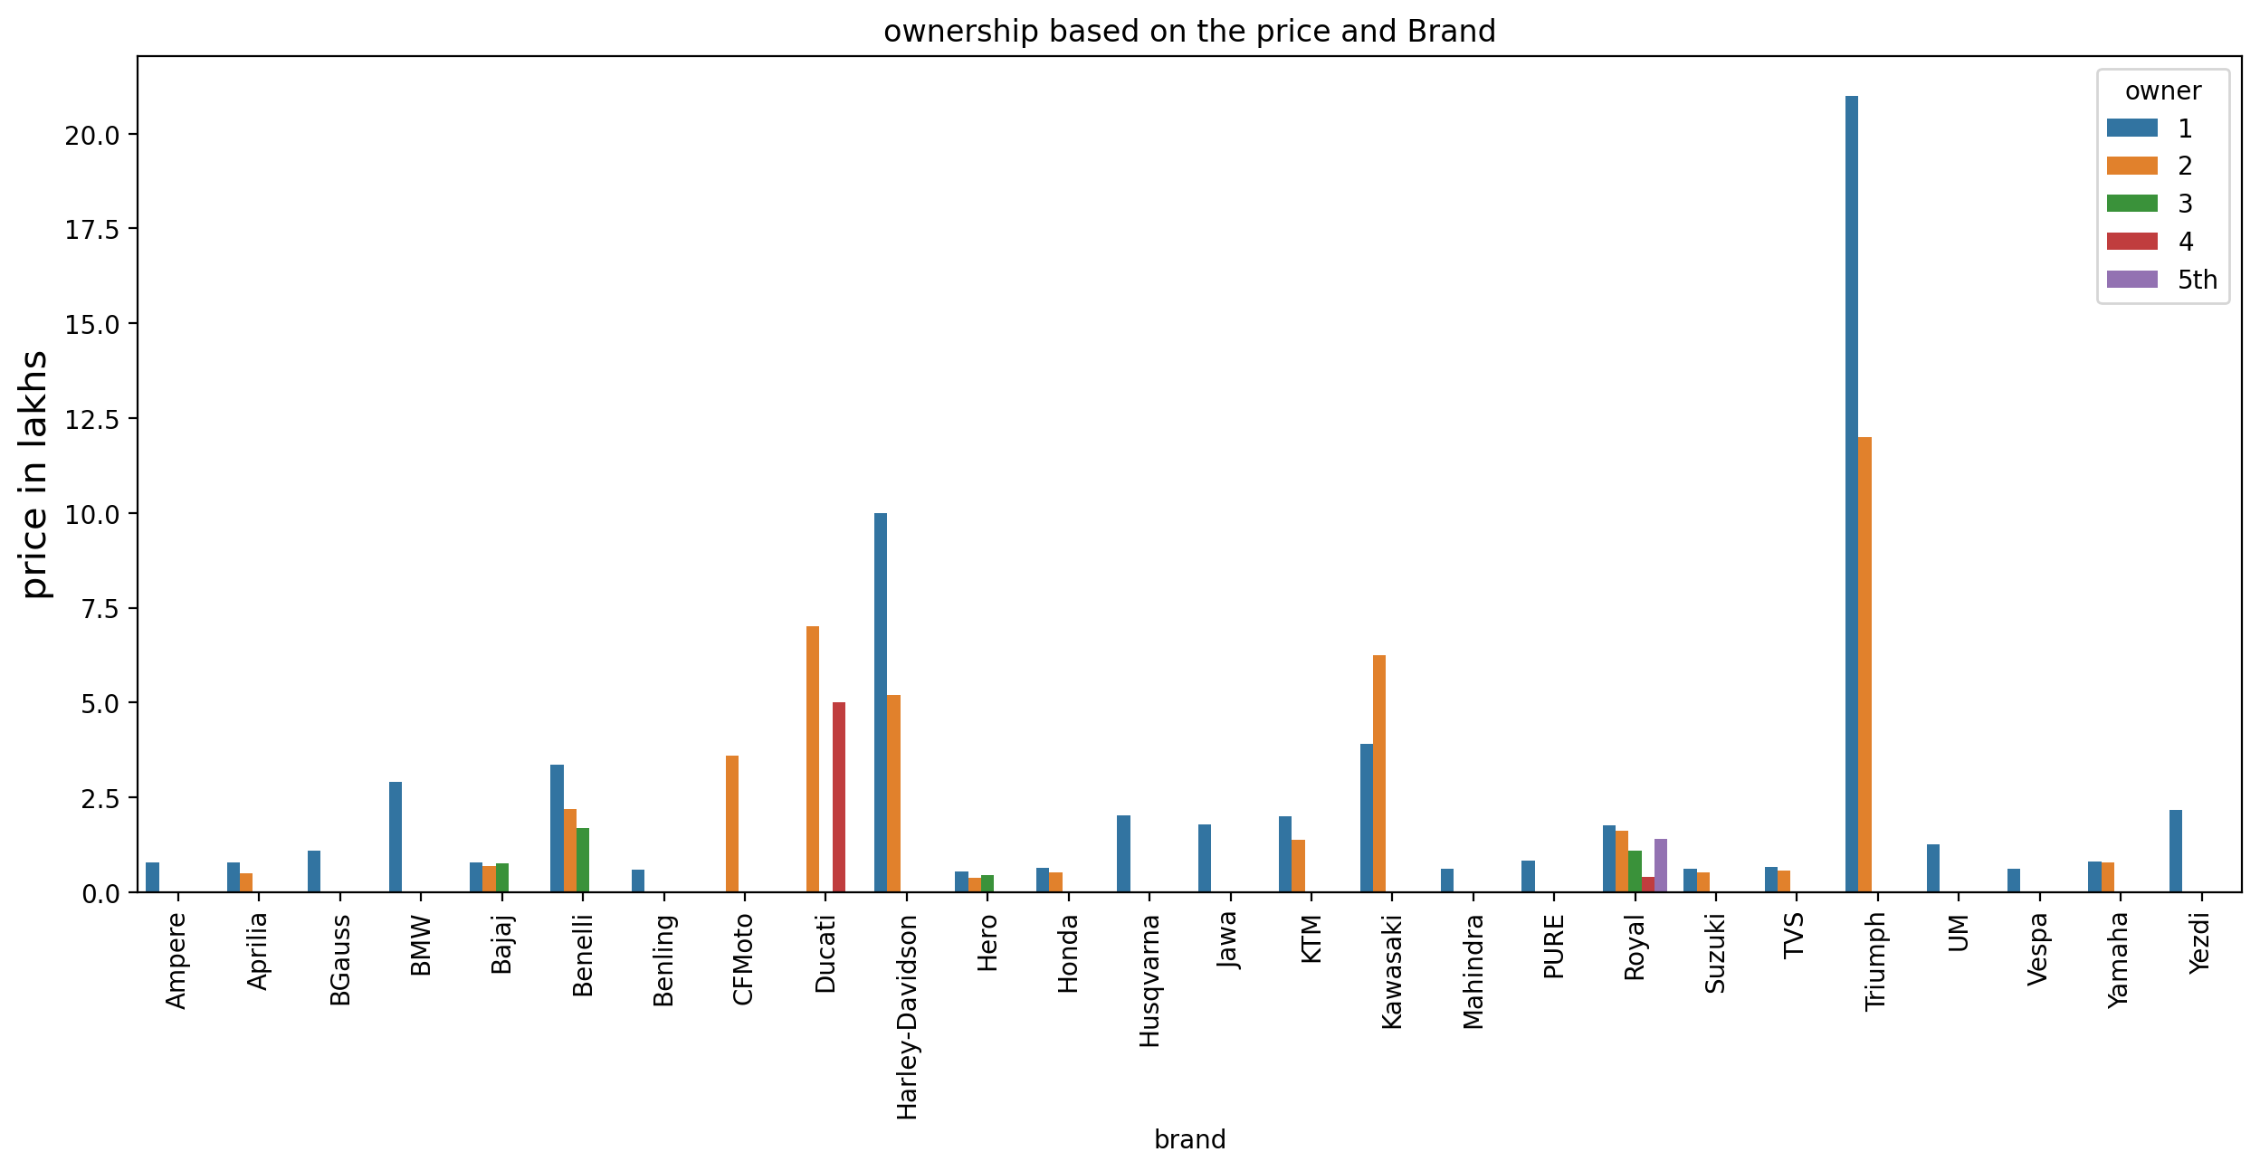
Ownership based on Price and Brand :
Price
Observation :
Here we can see that Triumph brand 1st owner used bikes prices are high.
Royal brand has 1st ,2nd ,3rd ,4th and 5th owner used bikes.

Slide 21

Conclusion :
We can conclude that in Pune the 1st owner used bikes prices are higher as compared to other cities.
We can conclude that if the model year increases the price of the bikes increases.
We can see that more affordable premium used bikes available are in the range of 2.5 lakh to 20 lakhs.
We can conclude that in brand Triumph the1st owner used bikes prices are higher as compared to other brands.

Slide 22


